Slide 1
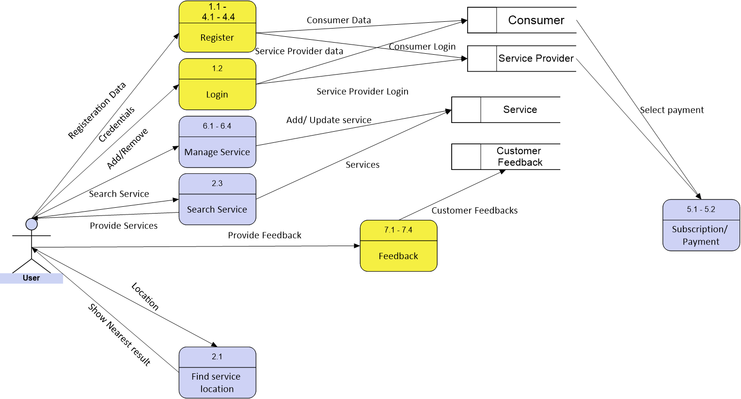
DFD - Physical

Slide 2
DFD - Logical - ServiceProvider
1.1 Create an Account
Registration data
6.2 Manage Map
Location
1.2 Sign into Account
Service Provider
Credentials
JSR name
4.1 Register Job Service
JSR properties
6.4 Manage Payment
Payment confirmation
4.2 Submit Job Service Request
JSR Confirmation
5.2 Schedule Payment

Slide 3
DFD - Logical - Consumer
1.1 Create an Account
Registration data
2. Customize Search
Search Query
1.2 Sign into Account
Consumer
Credentials
JSR name
4.2 Submit Job Service Request
JSR properties
4.3 Accept Job Service Request
JSR confirmation
5.2 Schedule Payment
User Comment
7.1 Create Feedback

